Slide 1

COMP3851A - Computing and Information Sciences WIL
Job Recruitment System (JRS)
Interim Technical Report
A centralized, web-based recruitment management solution streamlining end-to-end talent
acquisition, automated tracking, and secure corporate workflow management.
STUDENT GROUP MEMBERS
INDUSTRY SUPERVISOR
INSTITUTION
Zheng Chenjun, Si Huanjia, Shen Junye, Zhao Yikai, Yan Yibo
Chenghong Low
School of Computer & Info Sciences, UON
Job Recruitment System (JRS) - Interim Report Presentation

Slide 2

Industry Background & Problem Context
⚠ Legacy Recruitment Bottlenecks
Security & Process Vulnerabilities
Managing talent acquisition effectively is vital for enterprise growth.
However, many contemporary client organizations still rely on
fragmented, non-standardized channels:
Beyond operational sluggishness, ad-hoc manual recruitment
approaches introduce major security and compliance threats:
 PII Privacy Risks: Unencrypted resumes containing Personally
Identifiable Information stored on local drives.
✗ Fragmented Threads: Non-standardized email exchanges and local
spreadsheet tracking.
Version Control Chaos: Static document attachments prevent real-
time synchronization of candidate records.
✗ Data Silos: Information remains isolated across department
boundaries.
© The JRS Solution Goal: A centralized, web-based platform unifying
end-to-end recruitment workflows from job posting to offer
generation.
✗ Communication Delays: Slow feedback loops between hiring
managers and applicants.
✗ Inconsistent Evaluation: Lack of unified grading criteria across
recruiters.
Project Background & Context

Slide 3




Project Motivation & Core Drivers
Internal Talent Growth
Reduced Time-To-Hire (TTH)
Applicant Transparency
Establishes an organized, internal talent
acquisition process that empowers client
organizations to facilitate internal mobility,
retain key staff, and build structured talent
pipelines efficiently.
Automates application screening,
documentation, and status updates,
significantly slashing administrative costs
and shortening overall hiring lifecycles for
HR teams.
Demystifies the opaque hiring process by
offering candidates a dedicated user portal to
register, build modular profiles, track job
status, and manage resumes dynamically.
Strategic Motivation

Slide 4

Industry Solutions & Comparative Rationale
Evaluation Vector | Enterprise ATS (Workday, Taleo) | Manual / Ad–Hoc (Excel, Email) | Proposed JRS Platform
Financial Cost | Extremely expensive licensing fees | Zero initial software cost | Cost–Effective &In–House
System Complexity | Overly complex,bloated features | Unstructured,error–prone | Streamlined &Purpose–Built
Customizability | Rigid SaaS structures,hard to adapt | None;manual manipulation | Tailored to Client Processes
Data Privacy &PII | High compliance,but third–party hosted | High Security &Privacy Risk | RBAC &Hashed PII Security
Collaboration | Siloed by expensive user tiers | Version control chaos across inbox | Real–Time Sync for HR &Managers
Conclusion: JRS bridges the critical gap between overly complex enterprise software and insecure manual spreadsheets by offering an automated, tailor-fit recruitment management
portal.
Market Analysis & Rationale

Slide 5

Project Feasibility & 240-Hour Time Budget
The project feasibility was proven achievable within the mandatory 240-hour timeline by defining a tightly bounded functional scope and managing tasks via a
structured Work Breakdown Structure (WBS).
50 hrs
50 hrs
100 hrs
40 hrs
Requirements & HCI Design
Architecture & Database
Full-Stack Development
Testing, QA & Docs
Structured Project Governance Mechanisms:
Weekly Gantt chart updates to monitor task schedule variance.
Single shared GitHub repository for source version control.
Bi-weekly meeting minutes recorded and distributed to members.
Strict functional scoping focused on dual-role authenticated modules.
Resource & Schedule Governance

Slide 6
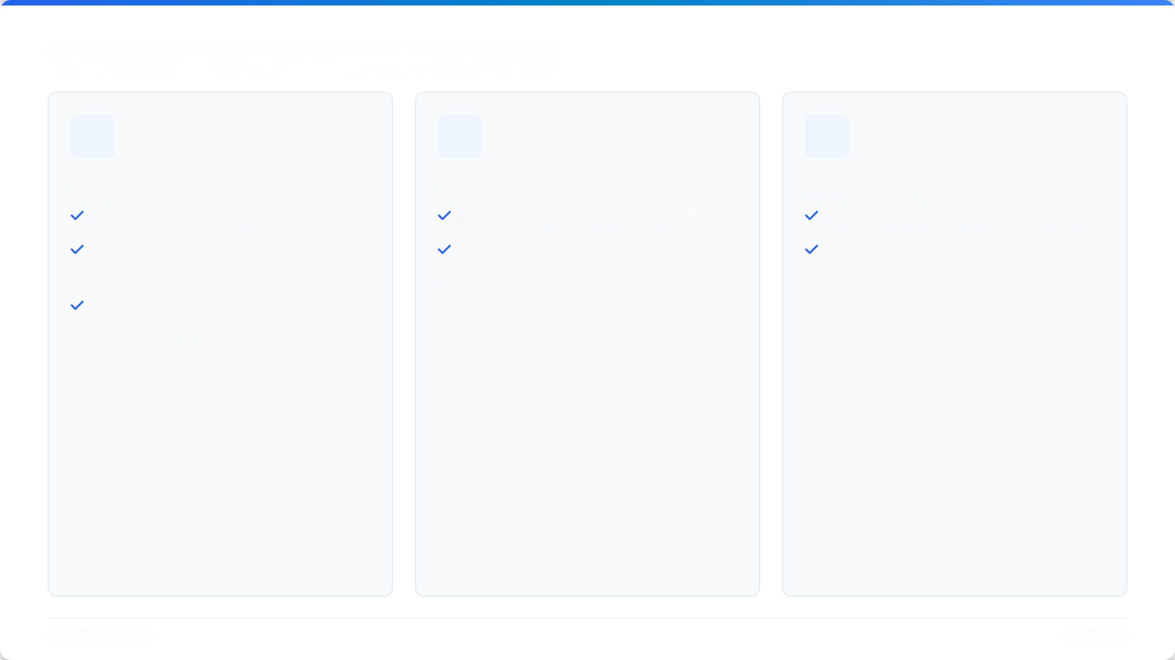



Team Technical Competence & Synergy
UI/UX Design & Prototyping
Architecture & Modeling
Database & Full-Stack
Proficient in Figma prototyping.
Mastery of UML standard notation.
3NF Relational Database normalization.
Modern UI engineering (component
variants, glass states).
Use Case & Sequence Diagrams.
SQL Schema & ER diagram engineering.
State Machine & Activity behavioral
modeling.
HTML5, CSS3 Flexbox, JavaScript,
React.
Responsive wireframes matching user
mental models.
Team Qualifications

Slide 7

Core Project Objectives (Aims A-E)
Aim A: Self-Registration & Account Management
Enables candidate registration, secure login, personal profile editing, career history, skills, and resume upload.
In Progress
Responsibility:Zheng Chenjun
Aim B: Job Application Submission & Real-time Tracking
Job portal allowing candidates to search vacancies, submit applications directly, and view real-time status updates.
In Progress
Responsibility:Si Huanjia
Aim C: HR Job Vacancy Posting Engine
Centralized management hub for HR personnel to author new postings, edit active vacancies, and close filled roles.
In Progress
Responsibility:Yan Yibo
Aim D: Candidate Review & Status Dashboard
HR dashboard to evaluate applications and dynamically transition stages (In Progress, Rejected, Offer Issued, Accepted).
In Progress
Responsibility:Shen Junye
Aim E: Automated Candidate Stage Progress Notifications
System-wide notification service informing applicants automatically whenever HR advances their stage status.
In Progress
Responsibility:Zhao Yikai
Functional Objectives

Slide 8

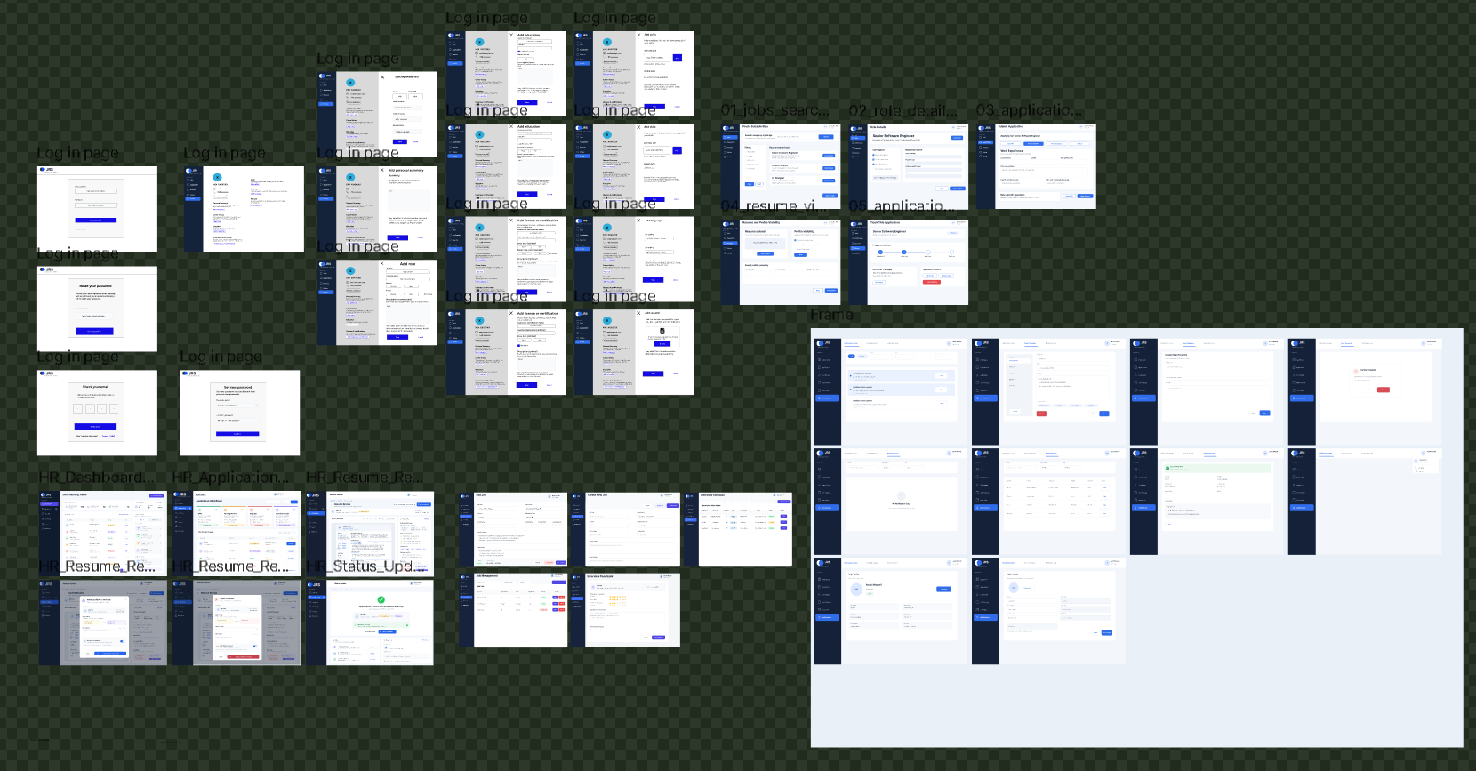
Methodology 1: HCI Prototyping & UX Design
User-Centered Interaction Flow
The team utilized Figma to design end-to-end user interaction flowcharts and
high-fidelity wireframes mapped directly to user mental models.
HCI Heuristic Evaluation: Applied principles to minimize cognitive load
during profile setup and job searching.
Responsive Multi-Platform Views: Crafted distinct responsive layout
frames for desktop web and mobile devices.
Single Source of Truth: Figma designs serve as the baseline visual contract
for front-end implementation.
Methodologies & Activities

Slide 9









Methodology 2 & 3: UML Modeling & 3NF Database
UML Behavioral Modeling
Database Normalization (3NF)
Unified Modeling Language (UML) specifications were built to define
precise system behavior before writing code:
Entity-Relationship (ER) models were normalized to Third Normal Form
(3NF) to guarantee transactional integrity:
Use Case Diagrams: Defining boundaries between HR and
Applicant roles.
Redundancy Removal: Disentangling applicant attributes into
separate entities.
Sequence Diagrams: Mapping object message interactions across
backend services.
Key Constraints: Enforcing strict 1:N Primary Key / Foreign Key
cascade rules.
State Machine Diagrams: Tracking status transitions (e.g.,
Application Pending → Offer Issued).
SQL Schemas: Generating standardized `schema.sql` executable
initialization scripts.
Methodologies & Activities

Slide 10
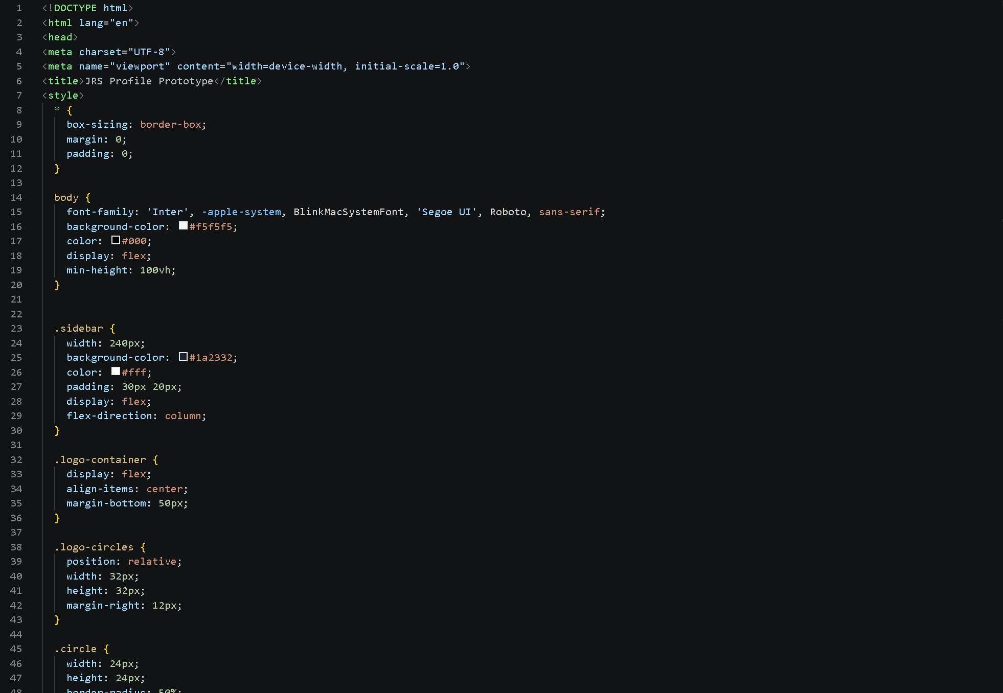
Methodology 4: Front-End
</> ：Front-End Layout Engineering
Figma wireframes were translated into working web components using
modern layout standards:
> HTML5 & CSS3 Flexbox: Building structured, responsive grid
containers.
> Two-Column Profiles: Self-taught dynamic profile cards and data
tables.
> Interactive Components: Smooth state triggers for modal forms
and status filters.
Front-End

Slide 11
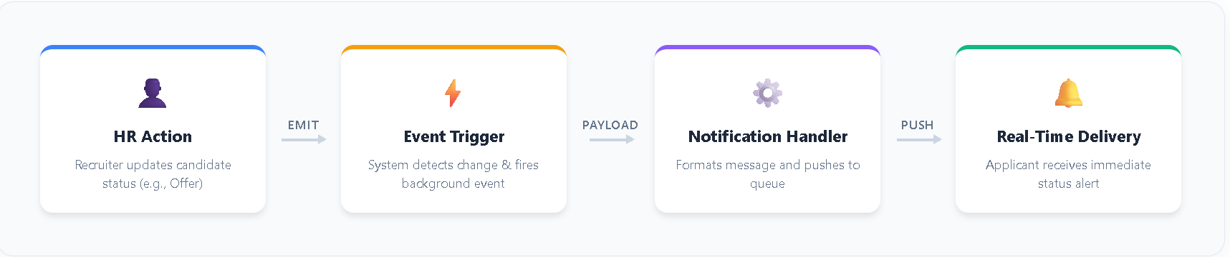
Methodology 5: Event Architecture
Event-Driven Notification Architecture
Designed automated notification handlers responding to recruitment stage updates:
> Event Triggers: Stage updates by HR automatically emit
background events.
> Real-Time Delivery: Informs candidates immediately of hiring
decisions.
> Notification Handlers: Formats and queues progress notification
messages.

Slide 12

Results: Functional Requirements Specification (FRS)
Req ID | Target Role | Functional Requirement Description | Mapped Aim | Status
FR-01 | All Users | Dual-role authentication securely segregating Applicants and HR Personnel. | Aim A | In Progress
FR-02 | Job Applicant | Modular candidate data store (Summary,Career History,Education, Certifications). | Aim A | In Progress
FR-03 | Job Applicant | Direct job application submission and real-time stage progress tracking. | Aim B | In Progress
FR-04 | HR Recruiter | Centralized job vacancy authoring,posting,updating,and listing closure. | Aim C | In Progress
FR-05 | HR Recruiter | Candidate application evaluation dashboard &dynamic stage update mechanism. | Aim D | In Progress
FR-06 | System | Automated candidate stage progression notification dispatch. | Aim E | In Progress
Results & System Specifications

Slide 13

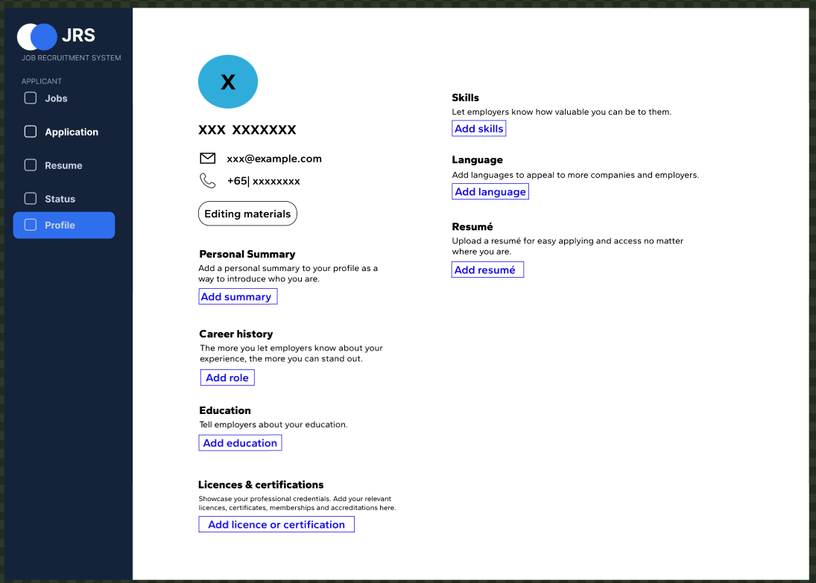



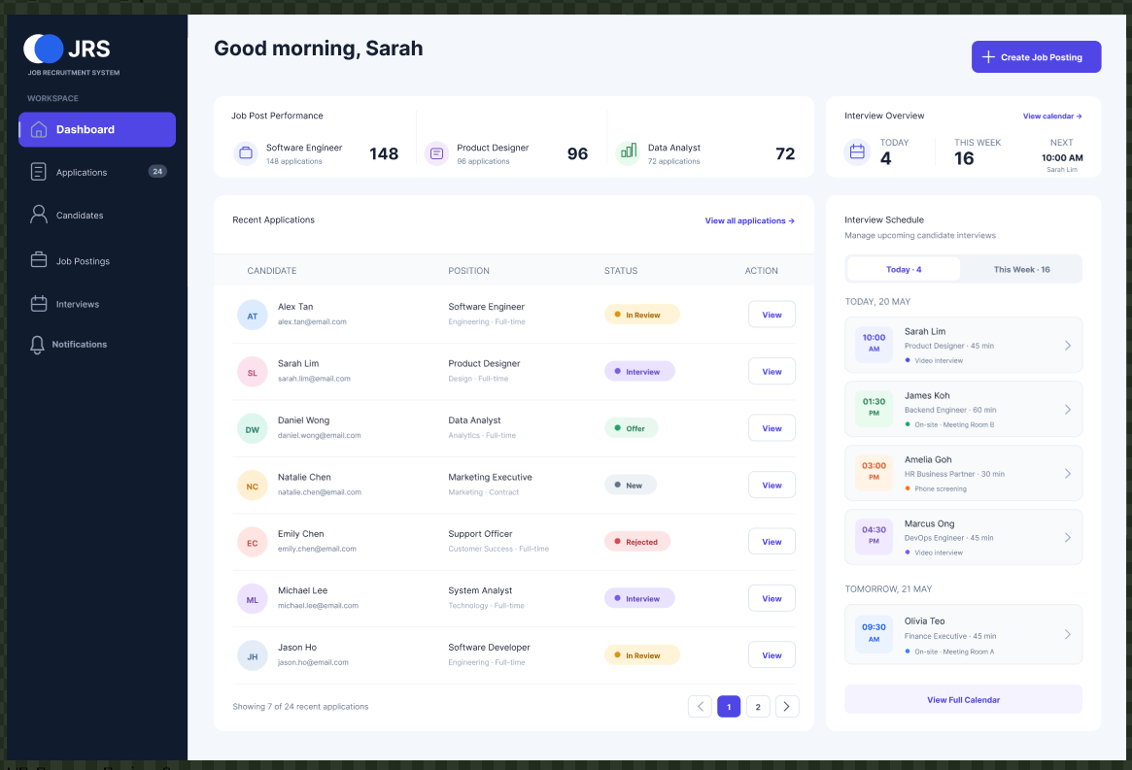
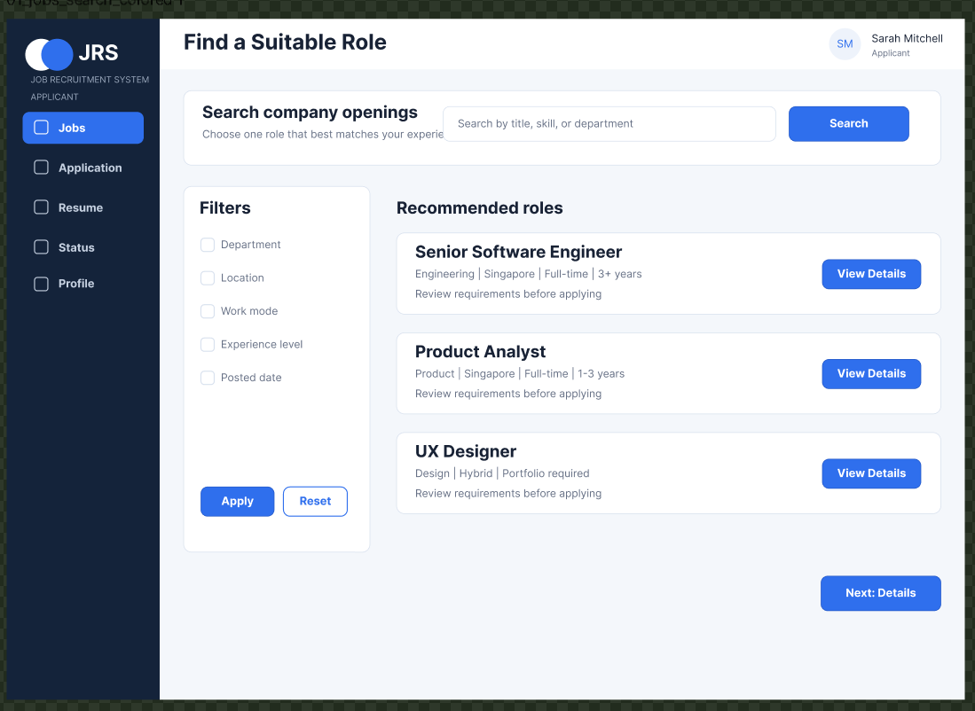
Figma UI Architecture: High-Fidelity Prototype
System-Wide Figma Specifications
The team established a comprehensive Figma design system acting as the
single source of truth for both web and mobile screens:
Dual Platform Frames: Complete screens for mobile viewports and desktop
browsers.
Applicant Workflows: Registration, profile editor, job feed, and application
status tracker.
HR Dashboard Workflows: Job creation wizard, candidate evaluation
matrix, and offer triggers.
Object:
Object:
Class name
Class name
Object:
Object:
Class name
Class name
Object:
class name
Figma Prototype Architecture

Slide 14
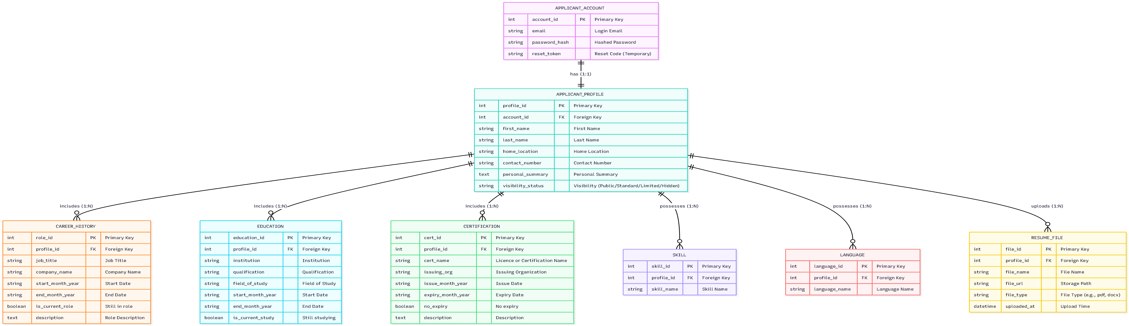




Database Architecture: 3NF Physical Schema
N
zz
Count
Relational Data Model Structure
N
APPLICANT_PROFILE: Central profile store ('profile_id', personal summary,
contact details).
Centered around APPLICANT_ACCOUNT and APPLICANT_PROFILE, the
database consists of 8 core normalized entities in 3NF:
Sub-Tables (1:N PK/FK Relationships): CAREER_HISTORY, EDUCATION,
CERTIFICATION, SKILL, LANGUAGE, and RESUME_FILE.
APPLICANT_ACCOUNT: Stores credentials ('account_id', 'email',
`password_hash').
Cascading Rules: Strict foreign key integrity enforcement on
deletion/updates.
Database Schema Implementation

Slide 15

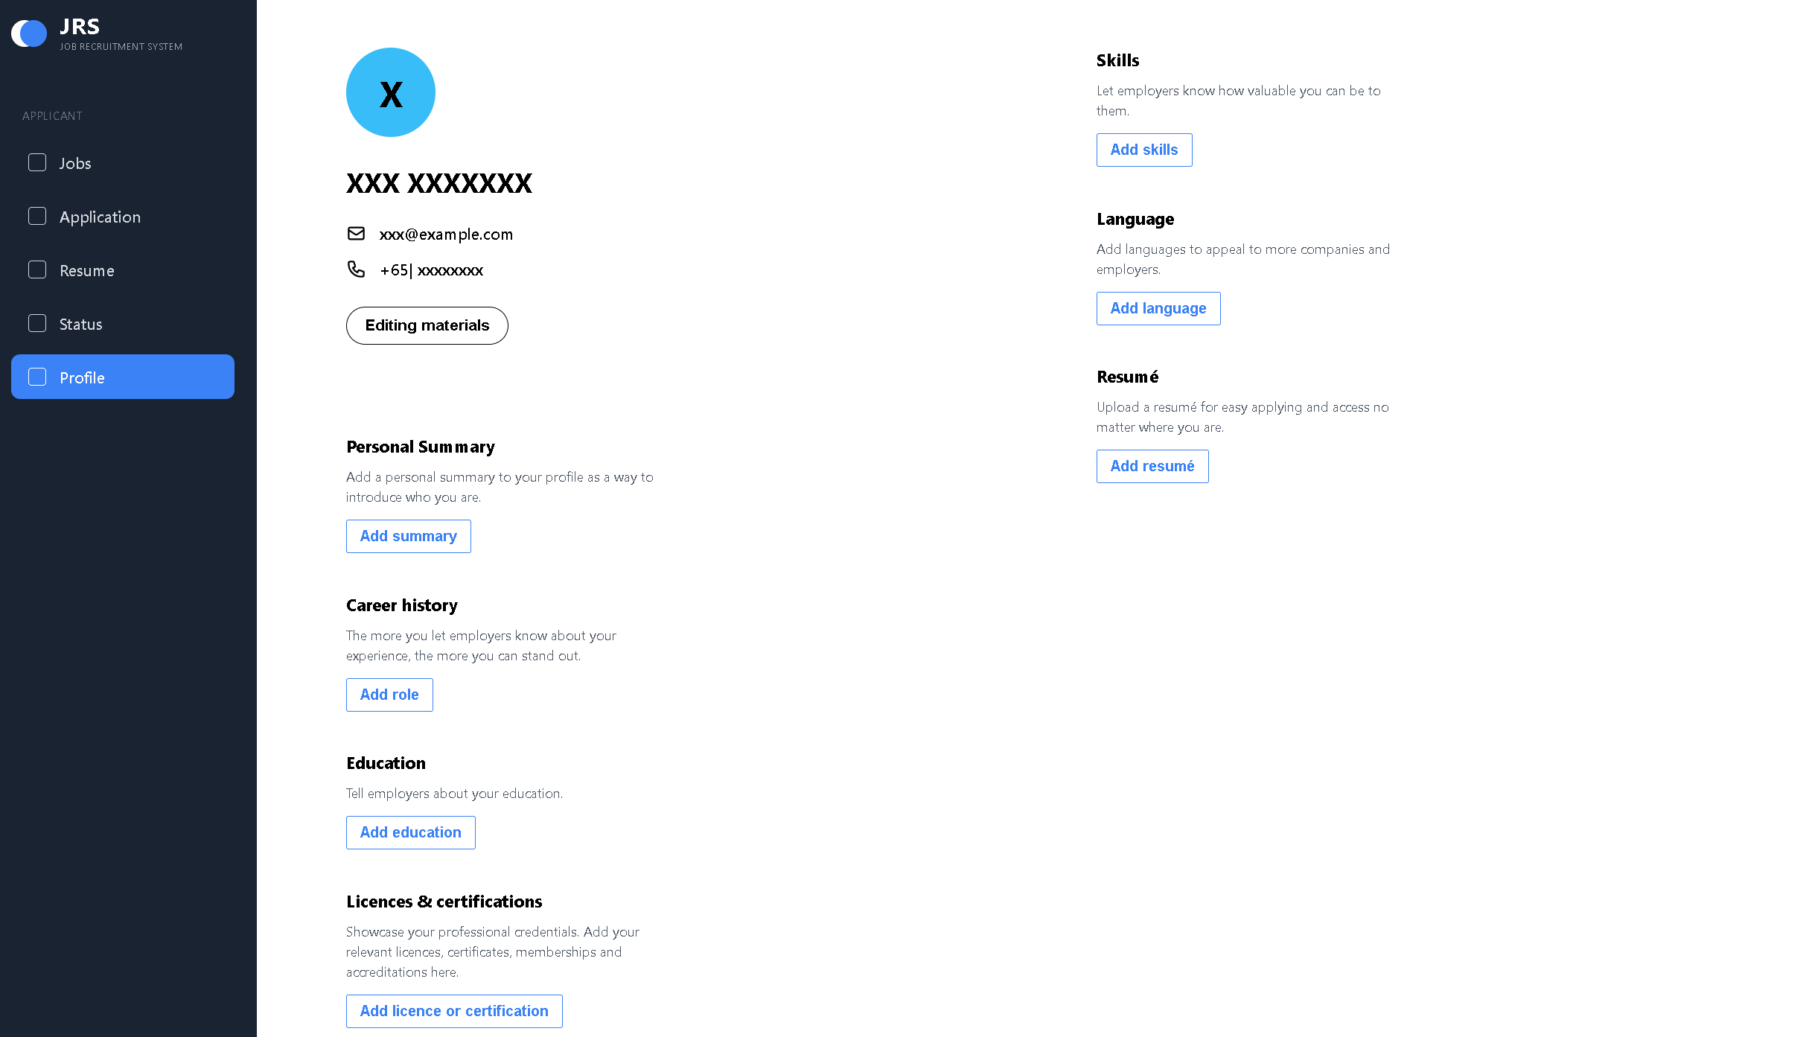
Front-End Engineering: Figma to Web Translation
The visual wireframes were successfully transformed into functional web pages. Below is the side-by-side comparison illustrating pixel-perfect fidelity from Figma
prototype to HTML/CSS layout.
High-Fidelity Figma Specification
</>Implemented HTML Layout
Two-column modular design with personal contact details on the left and career
materials (Skills, Languages, Resume, Experience) on the right.
Functional front-end code replicating exact element spacing, dynamic button
triggers, typography scale, and responsive layout behavior.
Data Dictionary Standardization: Resolved semantic model conflicts between team members (e.g., unifying "applicant" vs "candidate" definitions) to create a standardized data
dictionary for layout generation.
UI Engineering Translation

Slide 16




Critical Analysis: Key System Strengths
Seamless User Journeys
Normalized 3NF Architecture
Focused & Cost-Effective
Complete end-to-end mapping of user
journeys across high-fidelity wireframes
guarantees visual and operational
consistency, dramatically reducing cognitive
friction for both candidates and HR
recruiters.
Core Applicant Database normalized to Third
Normal Form (3NF) eliminates data
redundancy, guarantees transactional
integrity, and prevents relational update
anomalies.
Eliminates expensive, bloated enterprise
features in favor of a lean, secure, and
customizable web portal directly aligned with
corporate hiring needs.
Critical Analysis - Strengths

Slide 17



Critical Analysis: Current Limitations
A rigorous critical evaluation identifies three core technical limitations currently being addressed in Phase 2 of development:
Schema Integration Unification
Dynamic Backend API Data Binding
While the Applicant database structure is fully specified in 3NF, the standalone
ERDs for HR Job Vacancies and Candidate Evaluation modules are currently
undergoing consolidation into a single enterprise-wide SQL schema.
The current user interface operates as a static web skeleton. Active
development is underway to bind front-end views with live SQL database
queries via RESTful backend APIs.
Notification Service Execution: Backend event handlers designed for automated candidate notifications (Aim E) are logically modeled in UML but pending full
deployment on the server instance.
Critical Analysis - Limitations

Slide 18





Ethics, Data Privacy & Cybersecurity
Pillars of Architectural Safeguards
Because JRS handles sensitive Personally Identifiable Information (PII)
including contact details, resumes, and career histories, strict security
safeguards are built-in:
Credential Hashing: One-way secure hashing ('password_hash') prevents
password leakage.
Role-Based Access Control (RBAC): Restricts applicant data strictly to
authorized corporate HR personnel.
Algorithmic Fairness: Transparent "human-in-the-loop" HR reviews avoid
systemic automated rejection bias.
Ethics & Security Compliance

Slide 19




Regulatory Compliance Framework
Australian Privacy Act 1988
ACSC ISM Standard
OWASP Top 10 Guidelines
Strictly adheres to Australian Privacy
Principles (APPs) governing lawful collection,
storage, use, and destruction of candidate PII
documents.
Aligned with the Australian Cyber Security
Centre Information Security Manual
guidelines for secure software design and
data handling.
Implements web application security
standards protecting against SQL injection,
cross-site scripting (XSS), and broken
access controls.
Compliance Standards

Slide 20

Future Roadmap & Next Development Phase
MILESTONE 1
MILESTONE 2
MILESTONE 3
MILESTONE 4
Schema Integration
Backend API Binding
Notification Dispatch
QA & Security Testing
Consolidate HR vacancy ERDs with the
core applicant 3NF database schema
into a unified script.
Connect static front-end web layouts
to live SQL queries using dynamic
REST endpoints.
Deploy backend event handlers to
dispatch real-time candidate stage
notifications.
Execute full system integration tests,
OWASP vulnerability checks, and final
hand-off docs.
✅ DeliveryGuarantee:
With 140 development hours allocated to Full-Stack Implementation and QA, the remaining deliverables are fully on track for successful completion within the scheduled timeline.
Project Roadmap

Slide 21


Thank You!
Job Recruitment System (JRS) — Delivering an automated, secure, and user-
centric talent acquisition platform.
REPORT REFERENCES
Armstrong, M. and Taylor, S. (2020) Armstrong's Handbook of Human Resource Management Practice. 15th edn. London: Kogan Page.
Australian Cyber Security Centre (ACSC) (2024) Information Security Manual (ISM). Canberra: Commonwealth of Australia.
Codd, E.F. (1970) 'A relational model of data for large shared data banks', Communications of the ACM, 13(6), pp. 377–387.
Commonwealth of Australia (1988) Privacy Act 1988. Canberra: Federal Register of Legislation.
Elmasri, R. and Navathe, S.B. (2016) Fundamentals of Database Systems. 7th edn. Boston: Pearson.
Ferraiolo, D.F. and Kuhn, D.R. (1992) 'Role-based access controls', Proceedings of the 15th National Computer Security Conference, pp. 554–563.
Nielsen, J. (1994) Usability Engineering. San Diego: Academic Press.
Norman, D. (2013) The Design of Everyday Things. Revised and expanded edn. New York: Basic Books.
OWASP Foundation (2021) OWASP Top Ten Web Application Security Risks. Available at: https://owasp.org/www-project-top-ten/ (Accessed: 15 March 2026).
Pressman, R.S. and Maxim, B.R. (2020) Software Engineering: A Practitioner's Approach. 9th edn. New York: McGraw-Hill Education.
Silberschatz, A., Korth, H.F. and Sudarshan, S. (2020) Database System Concepts. 7th edn. New York: McGraw-Hill.
Sommerville, I. (2016) Software Engineering. 10th edn. Boston: Pearson.
Job Recruitment System (JRS) - Interim Report

